Slide 1
UNDERSTANDING WHY
DESIGN MATTERS

Slide 2
Understanding Why Design Matters
You have a theme. You even have a great cover.
Now it’s time to figure out what goes on each page of your yearbook.
Publication design is more than placing pictures on pages.
It’s more than picking pretty fonts.
It’s more than using green, “because it’s my favorite color.”
Good designers evolve and good design communicates.
It draws the reader in, it enhances stories, it drives your well-chosen theme.
Let’s get started…
walsworthyearbooks.com/yearbooksuite
Notes:
Basic Design should take one week to teach and then a week to practice and revise.

Slide 3
Let’s learn some VOCABULARY.
walsworthyearbooks.com/yearbooksuite

Slide 4
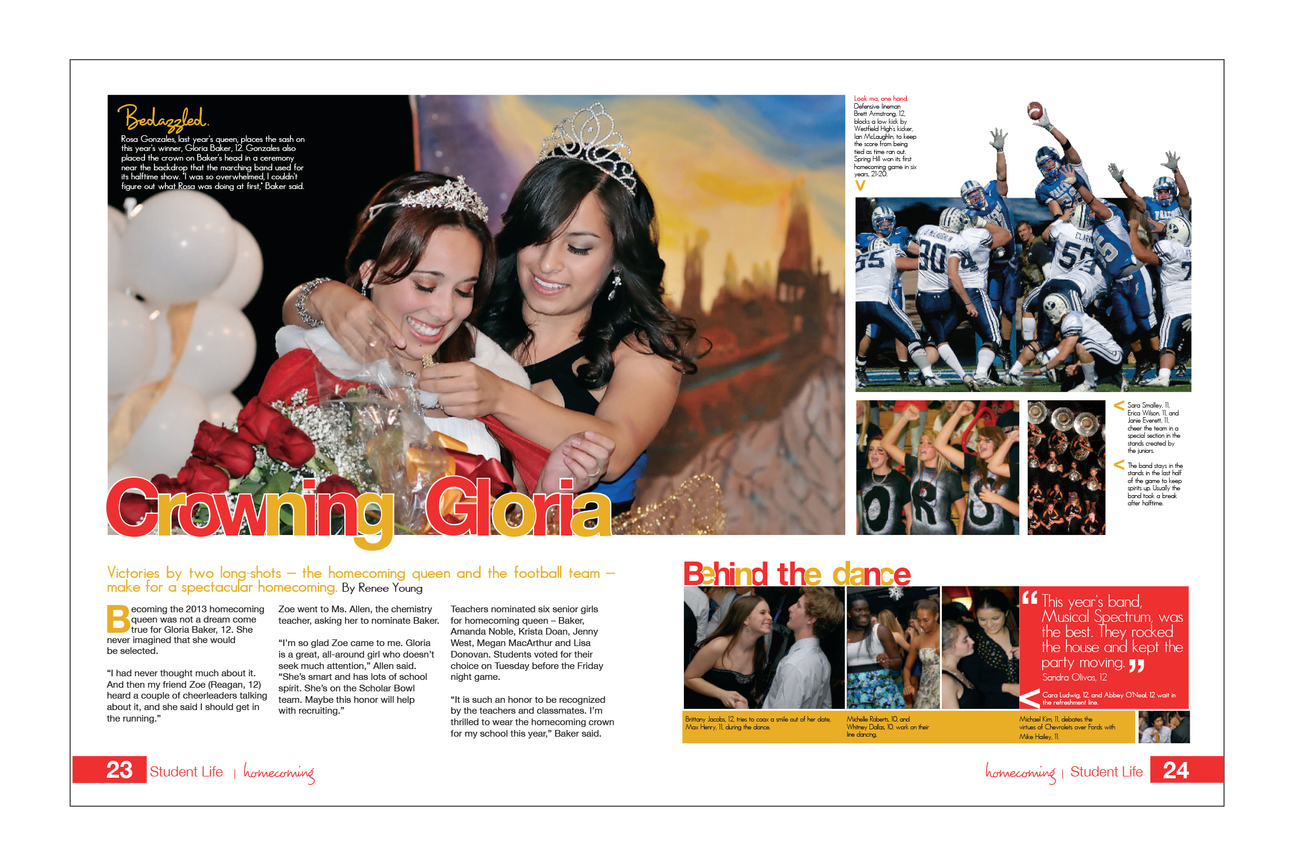
Caption: The copy that explains the Who, What, When, Where, Why and How of action in a photo; plan space for every photo to have a caption
Cut-out background (COB): A photo where the background is removed
Dominant element: The largest eye-catching photo or collection of photos or elements on a spread
Eyeline: A one-pica line that connects the left and right pages; all design elements should sit on or hang from this line
External margin: A margin of white space that will frame the edges of the spread
Copy: Refers to all text on a spread; copy includes captions, stories, headlines. All spreads need copy to help tell the story of the year
Folio tab: Words or phrases accompanying the folio identifying the content are called folio tabs
Folio: Page number on a yearbook spread
Bleed: Photos, artwork or graphics that extend off of the trim area of a spread
Double-page spread (DPS): Two facing pages; the left page is an even number
walsworthyearbooks.com/yearbooksuite

Slide 5
Internal margin/spacing: A consistent amount of white space between
elements; traditionally, this has been one pica. For this design unit, it shall remain one pica.
Headline: Word or words set in large type that attracts the reader to the spread; headlines traditionally are placed above copy blocks
Type: Printed letters or characters
White space/negative space: The absence of any element
Pica: A journalistic unit of measurement; one pica = 1/6 of an inch
Gutter: The place where the left and right pages meet; the gutter is often one or two picas wide and is folded as the book comes together.
Logo: Artwork used to represent a company; logos can be a unifying graphic for the yearbook theme
walsworthyearbooks.com/yearbooksuite

Slide 6
Lesson 1: Observing the Elements of Good Editorial Design
Objective — In this lesson, you will learn:
To understand and recognize what makes a strong visual design
walsworthyearbooks.com/yearbooksuite

Slide 7
Lesson 1: Observing the Elements of Good Editorial Design
Design helps communicate the story.
The chosen photos, type and graphics are arranged on the pages to help the reader.
Design elements are not just thrown down willy-nilly, there is a plan.
Looking at great design will allow you to understand the importance of how the elements communicate.
walsworthyearbooks.com/yearbooksuite

Slide 8
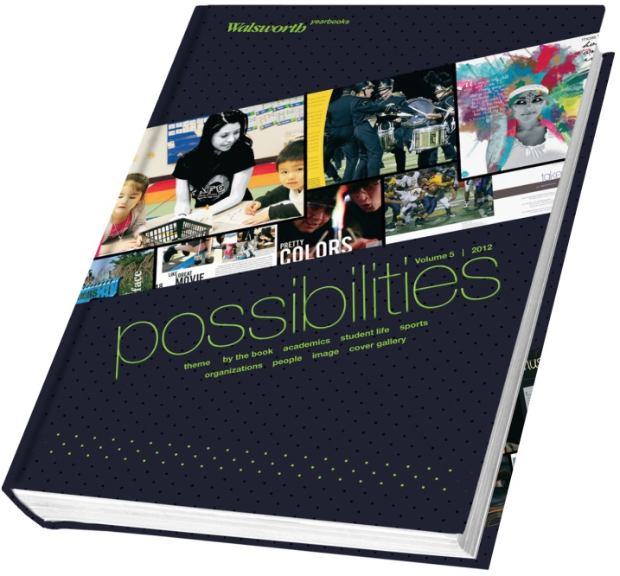
Lesson 1 Activity: Spotting Good Design Elements
Materials needed:
Several magazines, Walsworth’s Possibilities book, Walsworth’s “Perfect Packaging” poster, Pinterest
Look at several of the yearbooks featured in the Possibilities book.
Look for examples of the following:
Dynamic photography
Captions for all pictures
Eye-catching graphics
Use of color
walsworthyearbooks.com/yearbooksuite
Notes:
Ask students to notice the arrangement of materials on a spread. Answers should include:
· Large photo toward the middle
· Smaller photos
· All photos are rectangular
· Photos clustered toward the inside
· Writing to the outside of the pictures
· White space between the pictures is uniform/consistent
· White space is to the outside edge
Open a magazine like Entertainment Weekly, ESPN Magazine, Southern Living and you should also get the same responses. Use websites like Pinterest, and show different editorial design to the class; discuss your likes and dislikes of each spread. Again, focus on dominance, consistent font choices and inside margins.

Slide 9
Lesson 2: Starting With a Blank Page
Objectives — In this lesson, you will learn:
How to recognize a well-designed yearbook spread
Basic design concepts that include column structure, external margins, internal margins, eyeline, points and picas
walsworthyearbooks.com/yearbooksuite

Slide 10
Lesson 2: Starting With a Blank Page
When it comes to yearbook design, where do you begin?
Pages are designed as double-page spreads (DPS).
A double-page spread means the left and right pages are seen as one layout, one unit – a horizontal rectangle instead of two vertical rectangles.
The spread has external margins. This area has two jobs:
To create a frame of white space around the page
For the printer and the binder. The printer will trim the folded pages so they are neat as they sew them into the book.
walsworthyearbooks.com/yearbooksuite

Slide 11
Lesson 2: Starting With a Blank Page
You will be working in a journalistic unit of measurement called a pica.
One pica equals 1/6 of an inch. Each pica is made up of 12 points.
walsworthyearbooks.com/yearbooksuite

Slide 12
Math? In Yearbook?
Let’s do a math lesson!
If you have a 72-point headline, how many picas do you have?
How many inches is a 72-point headline?
walsworthyearbooks.com/yearbooksuite
Notes:
36 points = 3 picas
72 points = 6 picas
72 points = 1 inch

Slide 13
Three Areas
Now on to the actual page design.
For this, you need to think about three areas:
walsworthyearbooks.com/yearbooksuite

Slide 14
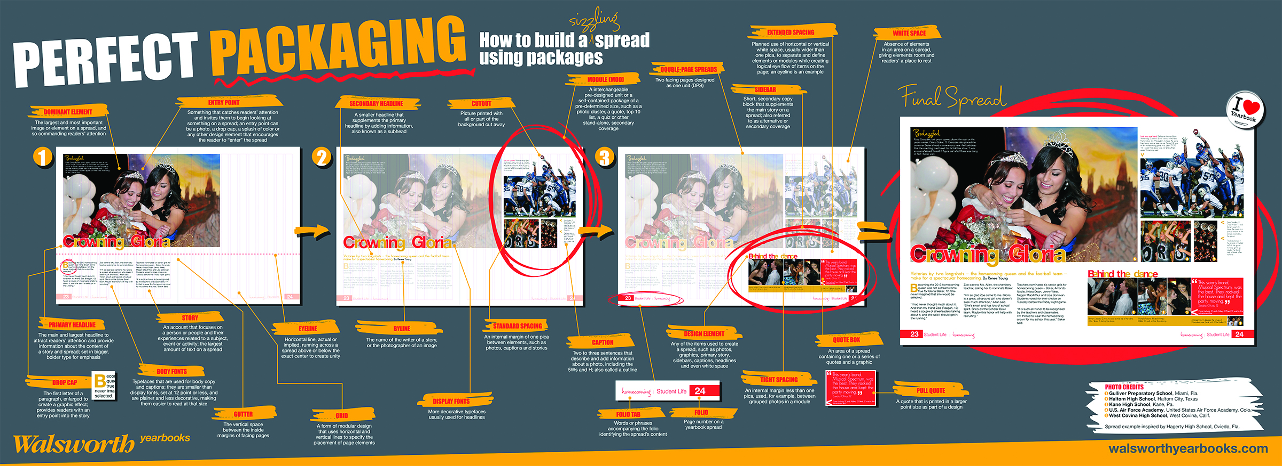
Perfect Packaging
Take a look at Walsworth’s “Perfect Packaging” poster. Notice that the dominant element is a large photo that is not directly in the middle, but is toward the center of the spread.
walsworthyearbooks.com/yearbooksuite
Notes:
Point out the following to students:
· Notice there are several similar photos placed around the dominant.
· Notice that the spacing between all pictures is consistent.
· Notice that the copy/captions are placed next to each photo.
· Notice that the story is in neat columns, and all elements have consistent spacing.
It’s important to emphasize the concept of entry points to your students when looking at a design. Where will the reader be drawn to the spread? How does the design communicate?

Slide 15
Lesson 2 Activity: Dominating Design
Often the first design element that you’ll begin with when designing a spread is a dominant photo.
This image sets the tone for the page and determines how the entire spread will be laid out.
Use the example templates and sketch how you’d design around a dominant photo.
Be sure to include areas for modular packages, copy, captions, headlines and additional photos.
walsworthyearbooks.com/yearbooksuite

Slide 16
Lesson 2 Activity: Manipulating Photos to Create an Eyeline and Consistent Internal Margins
Materials needed:
Various magazines, newspapers and yearbooks (preferably not your school’s book)
Walsworth layout sheets
8 ½ x 11 white paper
Take the sheet of white paper and fold in in half from top to bottom, short sides together.
Tear the paper in half.
Take one-half of the paper and fold that in half and tear it as well. Now you have two 1/4 pages.
Again, take one of those pieces and fold and tear it into two 1/8 pages.
Continued on next slide ➔
walsworthyearbooks.com/yearbooksuite
Notes:
Each student will have a layout sheet and a white piece of paper.
· Check to see if the class has all rectangles on the spread
· Check to see if dominant is placed toward the center
· Check to see if all elements are one pica apart
· Check to see if there is an eyeline
Once all students have the concept, let them play with different variations using all the same rules.

Slide 17
Lesson 2 Activity: Manipulating Photos to Create an Eyeline and Consistent Internal Margins
Now take the largest piece of paper and lay it down in the middle of the spread. Do not place it in the direct middle. Yes, it may and should cross the gutter.
Leave only one pica separation and lay down the next largest piece of paper.
Once the two are down, see if you notice an eyeline.
Now using the eyeline, place all pieces of paper leaving only one pica between each element.
All pieces of paper should sit on or hang from the eyeline.
walsworthyearbooks.com/yearbooksuite

Slide 18
Lesson 3: Designing a Basic Layout
Objective — In this lesson, you will learn:
How to create a yearbook spread using all the basic rules of design
walsworthyearbooks.com/yearbooksuite

Slide 19
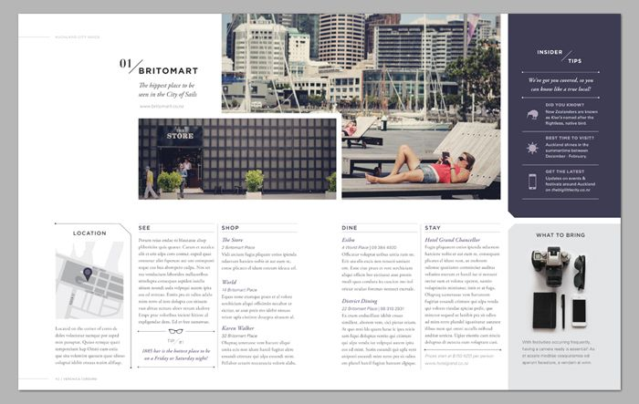
Lesson 3: Designing a Basic Layout
Creating a design means the designer places all elements (photos, copy, graphics) on a page in a planned manner.
Strong design will encourage the reader to study further and will cause them to react to the design.
walsworthyearbooks.com/yearbooksuite

Slide 20
Lesson 3 Activity: Time To Design
Take a size 7, 8 or 9 layout sheet and examine the external
margin, the pica structure and even the columns, which have been
established for you. If you fold the sheet in half, you will notice
the established gutter.
walsworthyearbooks.com/yearbooksuite
Notes:
Before students create their own designs, they should know what resources they will be using on the page. For example, even though dealing with photos doesn’t start until the second section of this activity, they should know what images they have to work with, and whether the dominant will be horizontal or vertical.

Slide 21
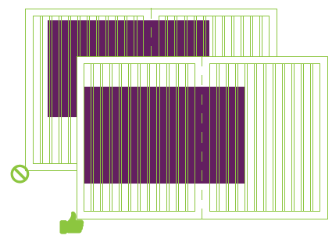
Lesson 3 Activity: Time To Design
To keep your internal margins consistent, use grids. When you design, simply remember to start and stop on a column.
walsworthyearbooks.com/yearbooksuite
Notes:
Walsworth suggests eight columns, but you may decide that 12 per page or 24 per double page spread works best for you. Advisers and editors should work with their sales rep to set up master pages for the entire book. Lock down the column and grid structure prior to teaching this portion of design. The column or grid you choose acts as the bones of your spread. It holds up everything that gets placed on the page and eventually printed, and helps you organize elements consistently.

Slide 22
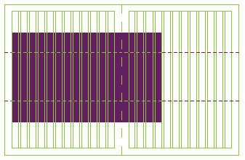
Lesson 3 Activity: Time To Design
Establishing an eyeline is the first step in creating an appealing design. You should never do this directly in the center. Choose a line 1/3 of the way from either top or bottom. The eyeline is a way of visually linking the left and right pages into one spread. Draw an eyeline on your layout sheet.
walsworthyearbooks.com/yearbooksuite
Notes:
Simply bring down the ruler and leave it on the spread to establish this eyeline. (Note: the ruler or guide will not print in your final copy of the book.)

Slide 23
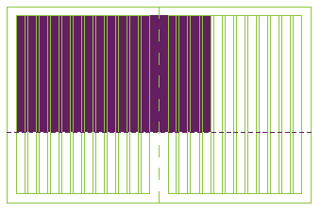
Lesson 3 Activity: Time To Design
Starting on a column and ending on a column, draw a large rectangular box that either sits or hangs from the eyeline.
walsworthyearbooks.com/yearbooksuite

Slide 24
Lesson 3 Activity: Time To Design
Choosing Photos
You should look at a variety of photos that have strong focal points, good composition and include a variety of people. Photos should convey the emotion you would like to express.
The strongest photo should become the dominant element. The bottom of the photo will sit directly on the eyeline. Place the photo in the box you drew in step 4 on the previous slide.
walsworthyearbooks.com/yearbooksuite

Slide 25
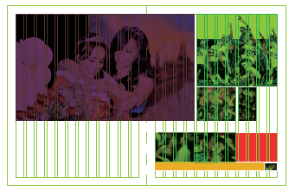
Lesson 3 Activity: Time To Design
Place remaining photos:
Place the supporting photos in the same manner; always sit or hang from the eyeline. Place the second best photo (preferably of opposite shape). Stay one pica from the dominant.
Place the third photo and always remember to start and stop on a column. Vary the shape of your photos.
walsworthyearbooks.com/yearbooksuite

Slide 26
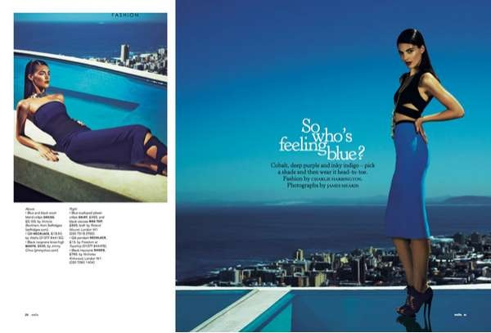
Lesson 3 Activity: Time To Design
Placing Captions and Copy
Now draw the caption areas and copy area. Remember, photos and captions will act to tell more in-depth coverage of the story. Thus, every photo should have a caption.
walsworthyearbooks.com/yearbooksuite

Slide 27
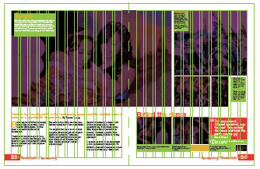
Lesson 3 Activity: Time To Design
Place the caption one pica away from the photo it describes. This one-pica separation will continue the use of a strong internal margin for the spread. All captions should be designed with the same width/column structure of the spread. The exception for this is group shots. Captions should also be kept to the outside, which will help maintain consistent internal margins.
walsworthyearbooks.com/yearbooksuite

Slide 28
Lesson 3 Activity: Time To Design
When placing photos in the center of a spread, you should leave an area to place the copy and the headline to the outside of the spread.
walsworthyearbooks.com/yearbooksuite

Slide 29
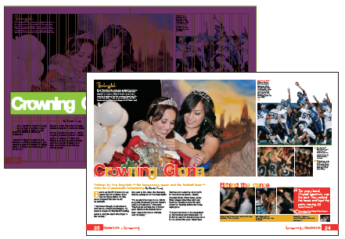
Lesson 3 Activity: Time To Design
Remember to leave room for the headline. A headline should cross over the top of the copy box and be large enough to attract the reader’s attention.
walsworthyearbooks.com/yearbooksuite

Slide 30
Lesson 4: Understanding Type
Objectives — In this lesson, you will learn:
How to recognize and use appropriate fonts and font families to tell a story
The differences in point size; and the difference between serif, sans serif and decorative type
walsworthyearbooks.com/yearbooksuite

Slide 31
Lesson 4: Understanding Type
At your computer, go to the Type pull-down menu and look at all the fonts you have at your fingertips. You can easily understand why students can get confused when choosing a font.
Some are easy to read, others are very decorative.
Always remember, readability is the key.
walsworthyearbooks.com/yearbooksuite

Slide 32
Lesson 4 Vocabulary
Ascender: The part of a lower case letter that rises above the main body of the letter
Bold :Type created with a heavy stroke. Bold type adds emphasis
Centered type: Both the left and right sides of a block of type are uneven
Condensed: The font width is narrow, but the height remains the same
Descender: The part of a lower case letter that extends below the main body of the letter
walsworthyearbooks.com/yearbooksuite

Slide 33
Lesson 4 Vocabulary
Drop initial (Drop cap): A highlighted letter that is set into the text that has the remainder of the text indented to accommodate the letter
Extended: The font is made wider and the height remains the same
Extra-bold: Type created with very heavy strokes to add emphasis (not good in large blocks of text)
Flush left: Type alignment that creates a vertically even line on the left side of a text box; some call this ragged right
Flush right: Type alignment that creates a vertically even line on the right side of a text box; some call this ragged left
walsworthyearbooks.com/yearbooksuite

Slide 34
Lesson 4 Vocabulary
Font: A complete set of letters, numbers, punctuation marks and
icons in a certain size of a printed character (also known as typeface)
Font family: A style of type/font in all its widths, weights and sizes
Italics The letters are slanted to the right: used to contrast the normal
version of the font
Justified type: Type alignment vertically even on both the left and right sides of a block of type
Kerning :The space between characters in a font
Leading: The negative space between lines of type; measured in points
walsworthyearbooks.com/yearbooksuite

Slide 35
Lesson 4 Vocabulary
Light: Type made with thin lines
Point: A journalistic unit of measurement; a point =1/72 of an inch; 12 points make up a pica. Type and graphic elements are measured in points and picas
Sans serif (without feet): A font with no finishing strokes at the ends
of each letter (traditionally works for headlines)
Serif (feet): A font with a decorative finishing stroke at the end of the
letter (traditionally works for body copy/captions)
Text wrap: Columns of text will flow around a graphic, art or photo
walsworthyearbooks.com/yearbooksuite

Slide 36
Lesson 4 Vocabulary
Ultra-light: Type made with very thin lines
Weight: The width of the lines that create a letter
Width: The horizontal measurement of a font
walsworthyearbooks.com/yearbooksuite

Slide 37
Lesson 4: Understanding Type
Fonts You Will Need
Once you have a theme and cover, choose fonts for the entire book.
Choose a decorative font to depict your theme.
a. Use this decorative font to enhance, not to tell the story
b. Use this font as a graphic treatment
Choose a contrasting font in either a serif or sans serif as your headline style font
a. All headline styles should be written in this font
b. Headlines traditionally have sans serif fonts (Myriad, Helvetica)
And finally, a body copy, caption, names font
a. Use this font throughout your book
b. Decide on a size 8-12 points
c. Pick a folio font for page number, section name, page content
walsworthyearbooks.com/yearbooksuite
Notes:
Open any book you have in your classroom. Show the students page after page of the same font and style. Let them know that books do not switch fonts. They may boldface or italicize, but the body copy font will remain the same and so does the size of that font.

Slide 38
Lesson 4 Activity: Font Identification
Find examples of various type styles. Using the list below, cut out the
example and match it with its name.
Materials needed:
Several old magazines, newspapers, college brochures,
posters (any printed material)
Glue
Type vocabulary list (from previous slides)
Ascender/Descender
Bold
Centered type
Condensed
Drop initial
Extended
Italics
Justified type
Kerning
Leading
Sans Serif
Serif
Text wrap
Ultra-Light
walsworthyearbooks.com/yearbooksuite

Slide 39
Lesson 5: Selecting Fonts
Objectives — In this lesson, you will learn:
How to choose a font family that will help convey the appropriate message in the yearbook
How to determine the proper font size and placement for your design
walsworthyearbooks.com/yearbooksuite

Slide 40
Lesson 5: Selecting Fonts
When you begin to decide on fonts, you should consider the theme.
For a classic theme: Garamond, Times or Helvetica would be appropriate for the voice of the book.
For a modern theme: Check out Futura, Gotham or Proxima Nova.
No matter your choice, remember to stick with a font family.
When looking for a family, look for a font that has a thick weight, thin weight, bold, italics and even ultra-bold and ultra-thin.
Some fonts will have serifs and san serifs. This provides the
contrast needed for headlines, sub headlines and copy without
sacrificing the voice of the book.
walsworthyearbooks.com/yearbooksuite

Slide 41
Lesson 5: Selecting Fonts
Body Copy
When making font choices, also decide on leading choices, justification choices and indent styles.
Fonts for main stories throughout the book should be consistent.
Depending on your font choice, body copy size should be set anywhere from 8-10 point. Theme copy is often larger, but not too large for a sophisticated appearance.
Serif fonts are also called Roman fonts. These fonts have small strokes at the ends of the letters. When set in long blocks of copy, the strokes help the reader distinguish between letters, thus making the copy easy to read. Old style/ traditional Roman fonts include Palatino, Garamond and Times.
walsworthyearbooks.com/yearbooksuite
Notes:
You can use Character Styles and Paragraph Styles in InDesign or Walsworth’s Online Design to maintain consistent font treatments easily. When typesetters were setting type in newspapers, the rule was an alphabet and a half. This translates to 26 + 13 characters = 39 characters wide.

Slide 42
Lesson 5: Selecting Fonts
Column Width
Use a column that is one and one half the size of the point size of your chosen font.
Therefore, if you have a 10-point font, you would use a 15-pica column.
Remember, you may use multiple columns to tell your story.
Making text too wide causes the reader distress.
walsworthyearbooks.com/yearbooksuite

Slide 43
Lesson 5 Activity: Picking Appropriate Body Copy Fonts
Materials needed:
Computer
Your basic design from Design Lesson 3
Using your basic design from Lesson 3, simply highlight the text for the body copy area. Replace the text with any decorative font.
Turn that decorative font into odd colors
Turn that decorative font into bold
Use the shadow command to change the font
Use the stroke command to change the font
After each change, decide if you would actually read that block of text.
More than likely, the answers will be a definitive “no.”
walsworthyearbooks.com/yearbooksuite
Notes:
With this activity, consider taking one of the basic designs and projecting it on a screen so the whole yearbook class can follow along.
For fun, have each student take the basic design they created and try to make it as unreadable as possible. Now, once they have an ugly template, let them go in and use the rules to find appropriate fonts, justification and leading.

Slide 44
Lesson 6: Headline Type
Objectives — In this lesson, you will learn:
Different styles of headlines and how to use them to create interest in a yearbook spread
What fonts work best for a headline and add visual appeal to a spread
How to determine the appropriate size for headlines
walsworthyearbooks.com/yearbooksuite

Slide 45
Lesson 6: Headline Type
The best yearbook staffs design their headlines.
Designers look to magazines, Pinterest or Design Shack for great examples.
Headline rules do vary more than the body copy rules. Why? Because headlines are larger and are made to attract attention.
You know that decorative font you used on your cover? It is OK to now use that font in a letter or word; never the entire headline.
Therefore, it is important that you select a headline font that will contrast nicely with your theme font. In other words, two serifs will probably not mix well.
walsworthyearbooks.com/yearbooksuite

Slide 46
Lesson 6: Headline Type
Instead of using multiple fonts, use a texture, color or even
different capitalization formats to add the desired emphasis.
Remember, headlines attract. That’s their job.
When someone wants to attract attention, they get dressed in their best outfits.
Yearbook headlines need to think in the same manner.
walsworthyearbooks.com/yearbooksuite

Slide 47
Lesson 6: Headline Type
Headlines should be varied in design, but consistent in font choice.
This is where the imagination and creativity will really come in to play.
When setting your headlines, never just type it and walk away.
Your design program will use a default kerning. You should never just allow the default to do your work.
Change the kerning so the letters are tighter or spaced to help you attract attention.
walsworthyearbooks.com/yearbooksuite

Slide 48
Lesson 6: Headline Type
Pairing fonts is also essential to attract attention.
Often, the theme will use a script or cursive font.
The best place to carry this font through in the yearbook is the headlines.
However, be careful. The best use of a script is in a large font.
Scripts look best using the first letter in caps and subsequent letters
in lower case, not all caps.
Headlines work in all caps in some fonts. Body copy or captions will not.
All caps in large blocks of text are difficult to read. Modern publications
are setting the headlines in all lower case. Whatever your choice, just be consistent.
walsworthyearbooks.com/yearbooksuite

Slide 49
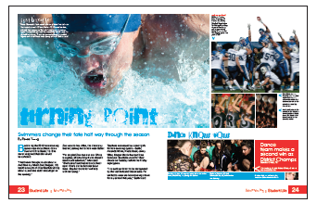
Lesson 6 Activity: As a Matter of Font
Use two contrasting fonts to create different looks for these headlines:
Dance Know How Dance team makes a second win as District Champs
Turning Point Swimmers change their fate half way through the season
Prying Eyes Photo Club works with professional to develop
Once you have completed creating the headlines, add them to the
basic design spread you created in Lesson 3.
walsworthyearbooks.com/yearbooksuite

Slide 50
Lesson 7: Creating a Secondary Coverage Package
Objective — In this lesson, you will learn:
How to manipulate a basic design to accommodate more coverage, photos and information
walsworthyearbooks.com/yearbooksuite

Slide 51
Lesson 7: Creating a Secondary Coverage Package
At this point, a book created with the design rules you have learned
so far will be visually appealing to the reader.
However, there is little difference from one spread to the next.
Most spreads have only five to seven photos. The story is there, but there is little area to explore and report more information.
So now it is time to add some variety to the spreads.
Work with one of the photo areas you have created.
Decide on a photo area and simply design a secondary coverage package in that chosen area.
walsworthyearbooks.com/yearbooksuite

Slide 52
Lesson 7 Activity: A Different Approach
Materials needed:
A current magazine
Pinterest inspiration or brochure
1. Pick one photo area in your basic design. Eliminate that photo.
2. Use Pinterest or a magazine and find some inspiration for a
package element. Inspiration could include:
Q&As
Calendars
Top 10
Narratives
FYI boxes
Quotes with a candid portrait (don’t take mug shots against a wall)
walsworthyearbooks.com/yearbooksuite

Slide 53
Lesson 7 Activity: A Different Approach
3. Explain in one paragraph how your design inspiration will relate to the spread. The explanation should include:
Why this is unique to the spread
How it relates to the year
Whether it includes diverse groups of people
How it will help explain the before, during and after the event covered
walsworthyearbooks.com/yearbooksuite

Slide 54
Lesson 7 Activity: A Different Approach
4. Using the same fonts, create a mini headline. This look can be a contrast to the main headline by flipping fonts or changing color. But it should be consistent with the main headline. It should also be 2/3 smaller than the main headline. Now design in the area where the photo used to be.
Can be a small area to the outside
Can be a larger area with a group of three photos, a gang caption and headline
Can be a dominant package with several photos instead of one
5. You should do this to one or two areas on the spread. Leave all the rest alone. Make sure they are balanced so not all packages appear on one side. This will create entry points, so a reader can decide what information they would like to obtain and in what order.
walsworthyearbooks.com/yearbooksuite
Notes:
Secondary coverage packages:
· Can be a small area to the outside
· Can be a larger area with a group of three photos, a gang caption and headline (a gang caption is one large caption about all photos)
· Can be a dominant package with several pics instead of one

Slide 55
Lesson 7 Activity: A Different Approach
walsworthyearbooks.com/yearbooksuite

